Slide 1
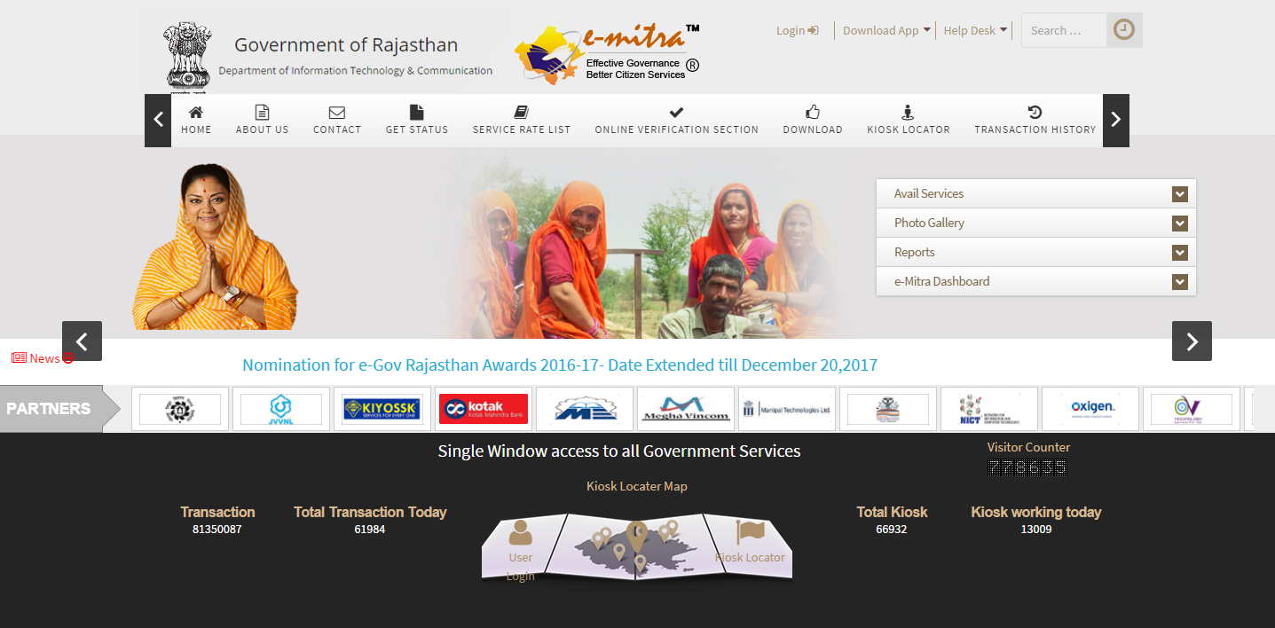
http://emitra.rajasthan.gov.in/content/emitra/en/home.html
Open this URL in any web browsers (Chrome, Internet Explore, Mozilla Firefox etc.) and Click on Login Option. (Arrow showing Login option)
How to Use for GSP Return’s Service

Slide 2
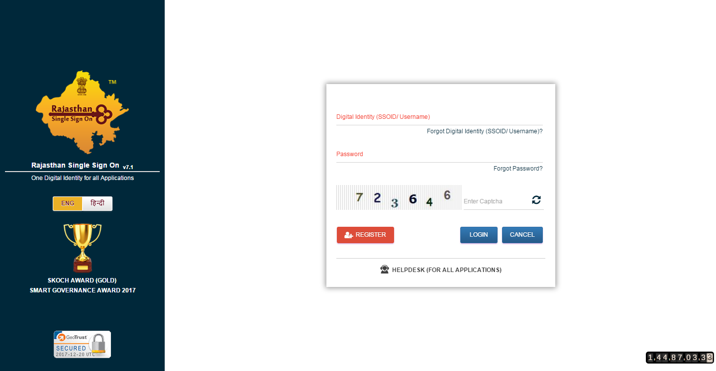
Here type your SSO ID, Password with Captcha code and click login button.

Slide 3
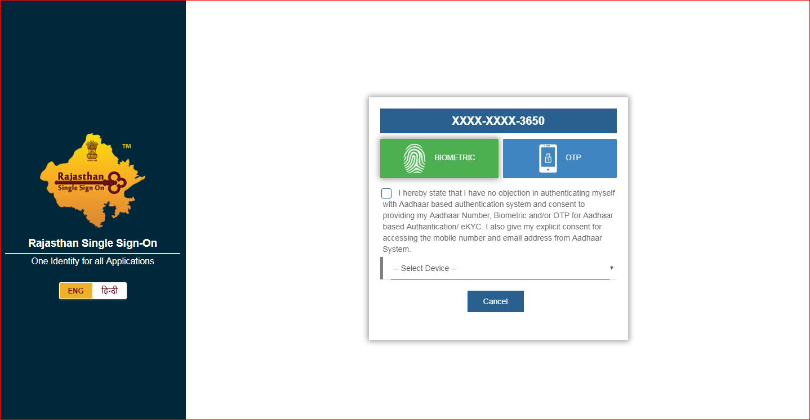
After Clicking on Login Option, this page will appear. Please type OTP sent on your mobile registered with UID.

Slide 4
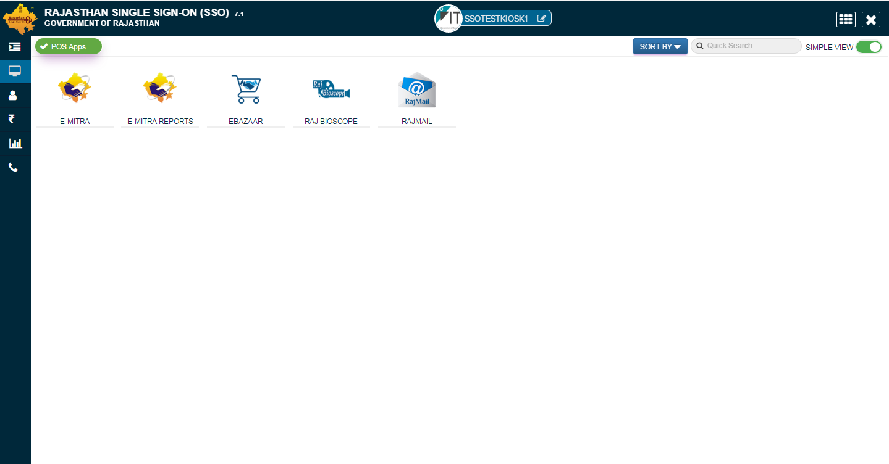
After Successfully login, this page will appear Now you should click on E-MITRA option.

Slide 5
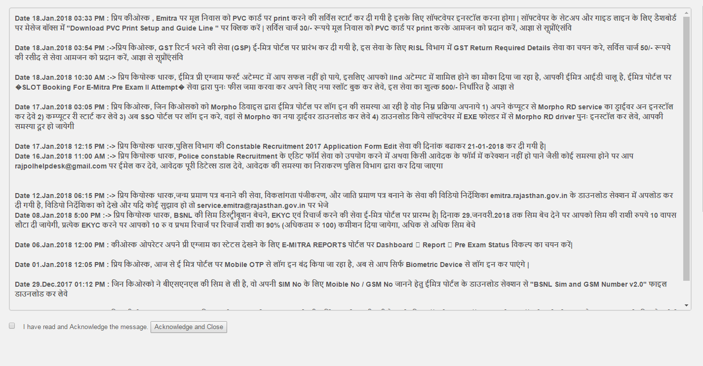
Click on E-MITRA Option, this page will appear here, you can see the message about GST Return, you have to select on “I have read and Acknowledge the message” option and click on “Acknowledge and close” button.

Slide 6
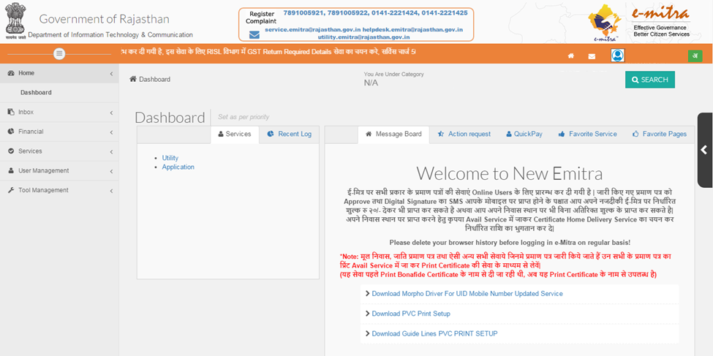
On e-Mitra dashboard page, click on Application option.

Slide 7
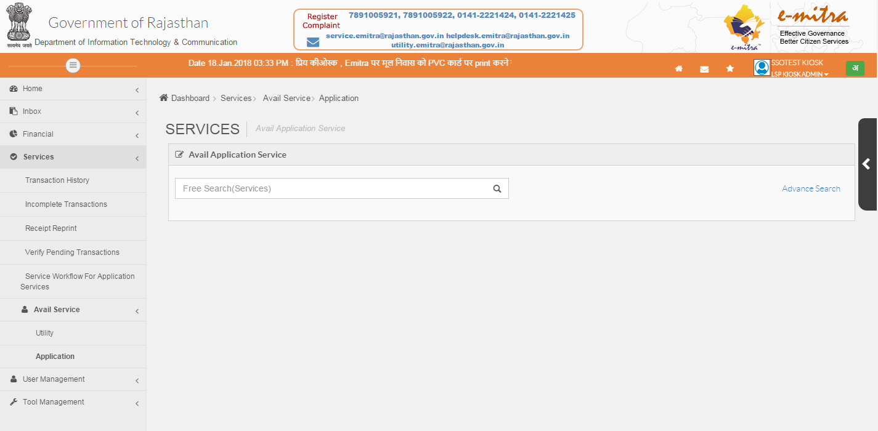
On this page, search GST Return Required Details (जीएसटी के लिए आवश्यक विवरण) Service in search box.

Slide 8
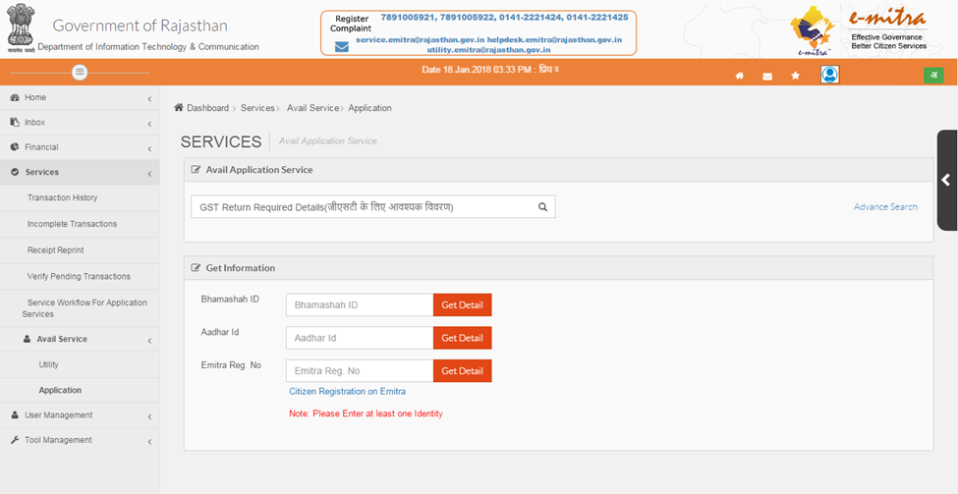
Enter any one of id in following options, Bhamshah Id| Aadhaar Id| Emitra Reg. No. and click on Get Detail button.

Slide 9
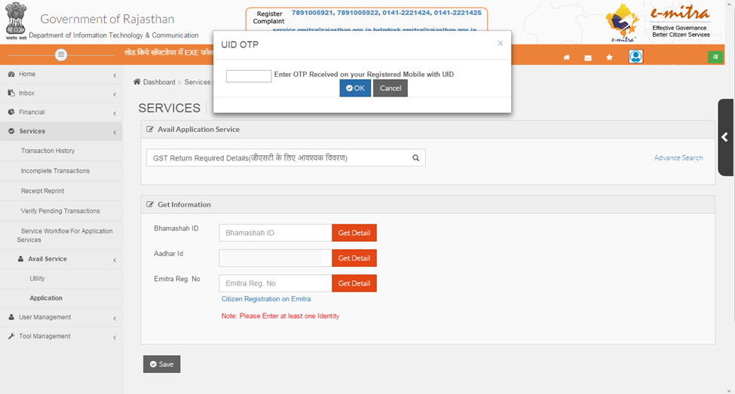
If you choose Aadhaar Id, then should enter OTP, Received on Registered Mobile No. with UID and Click OK Button

Slide 10
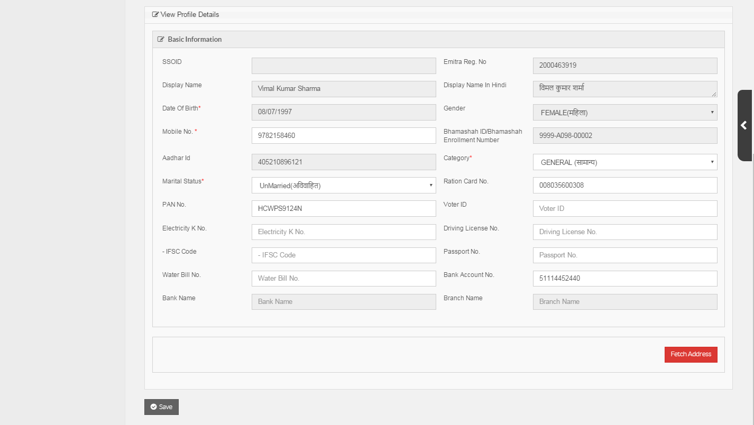
After Click Ok Button, A form will be display as Name “View Profile Details” check all basic information and fill mandatory fields. Now click on fetch address

Slide 11
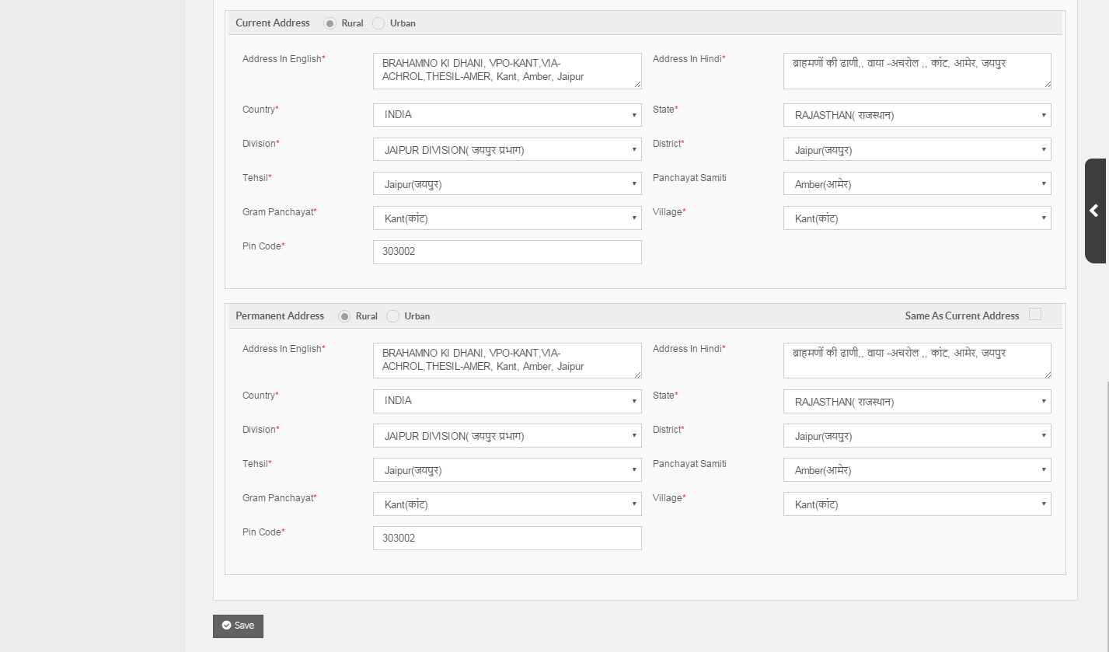
After Click on Fetch Address option, this page will come, here you can see your address details fetch with UID and also fill mandatory fields. Now click on Save Button.

Slide 12
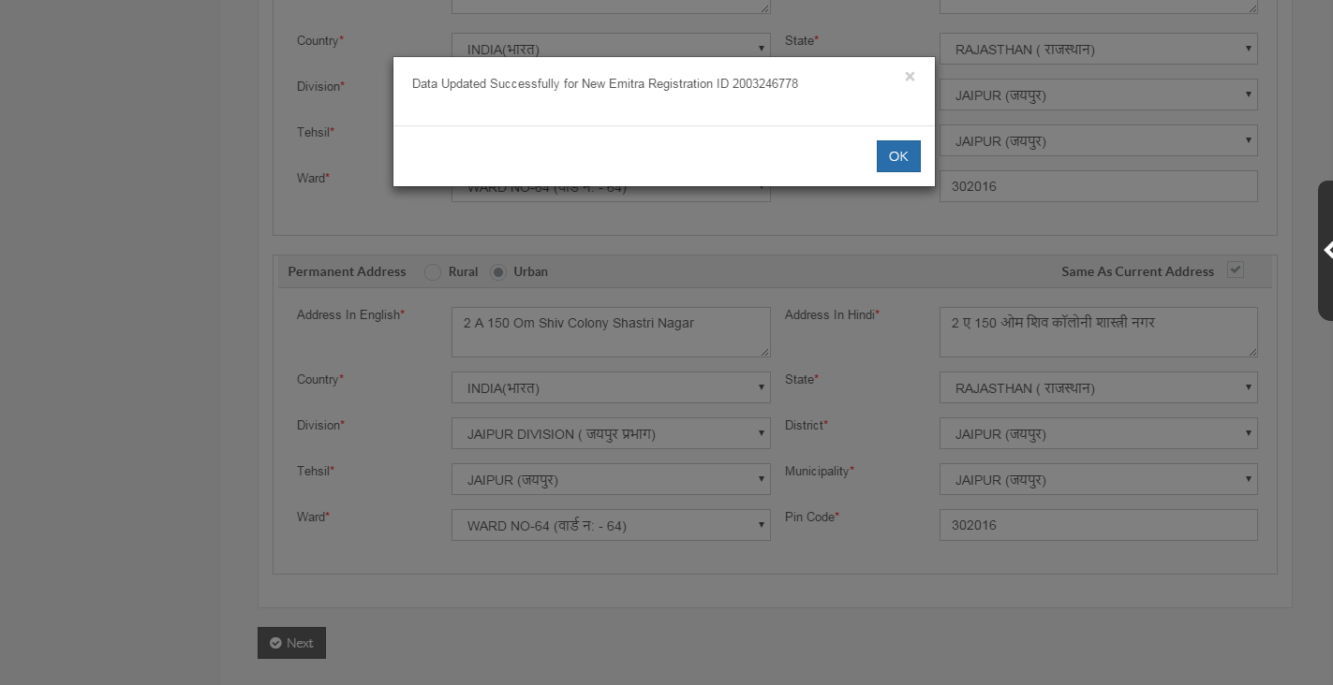
After click on Save Button, A pop-up message “Data Updated Successfully for New Emitra Registration ID 2003246770” will come, Now click OK Button Now

Slide 13
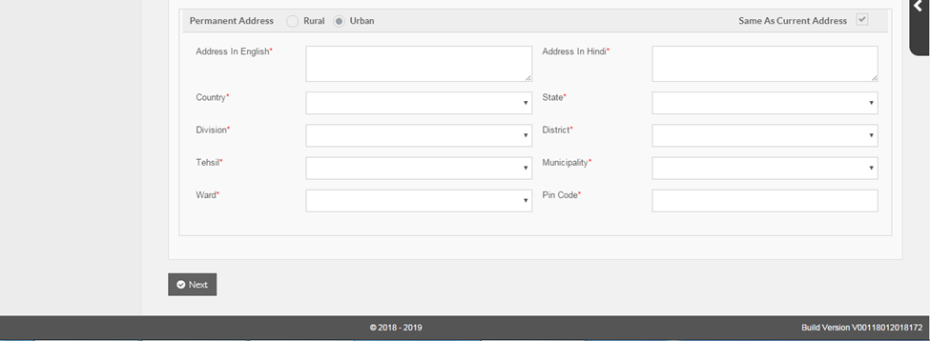
After Click on OK Button, Click on Next Button showing bottom on the Screen.

Slide 14
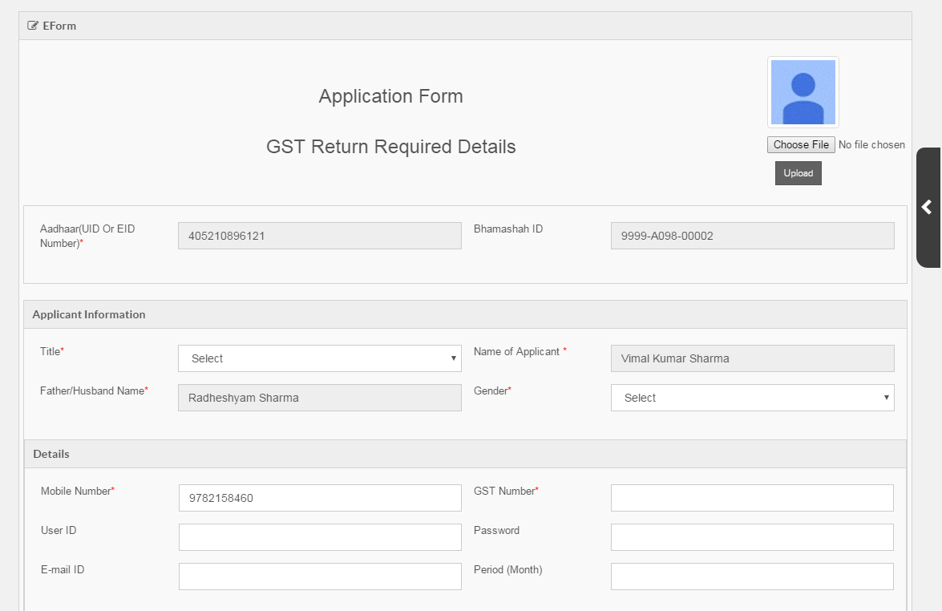
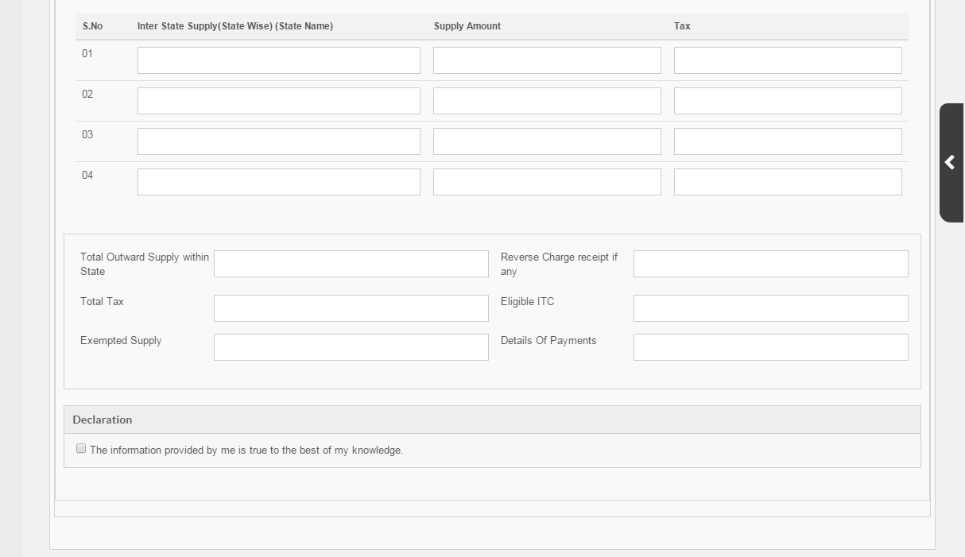
After Click on Next Button, A new page will come, here you must fill all fields like Title, Gender, GST No., User Id, Password, Email, Period (Month जिसकी Return भरनी है ।), Inter State Supply, Total Outward Supply, RCM, Total Tax, Eligible ITC, Exempted Supply, Details of Payments. After Fill all required details, Select on Declaration option.

Slide 15
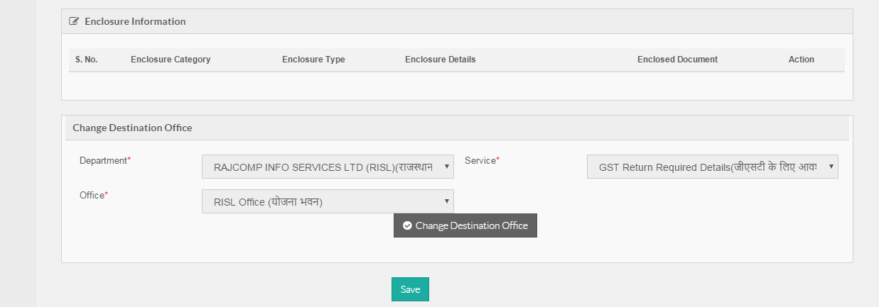
After Select on Declaration option, Now Click on Save button showing bottom of the screen.

Slide 16
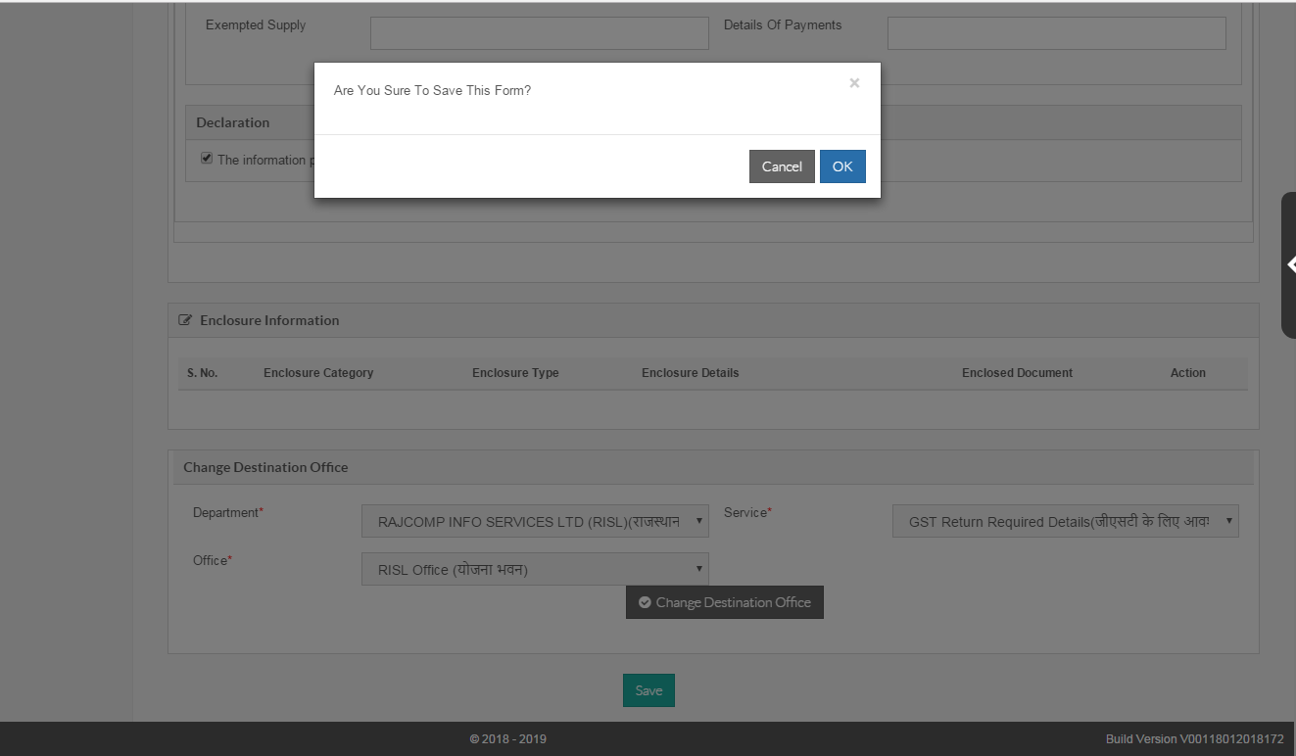
After click Save Button, a Pop-up message “Are you sure to save this form ”will come. If you fill all required details right click on OK option otherwise click cancel option.

Slide 17
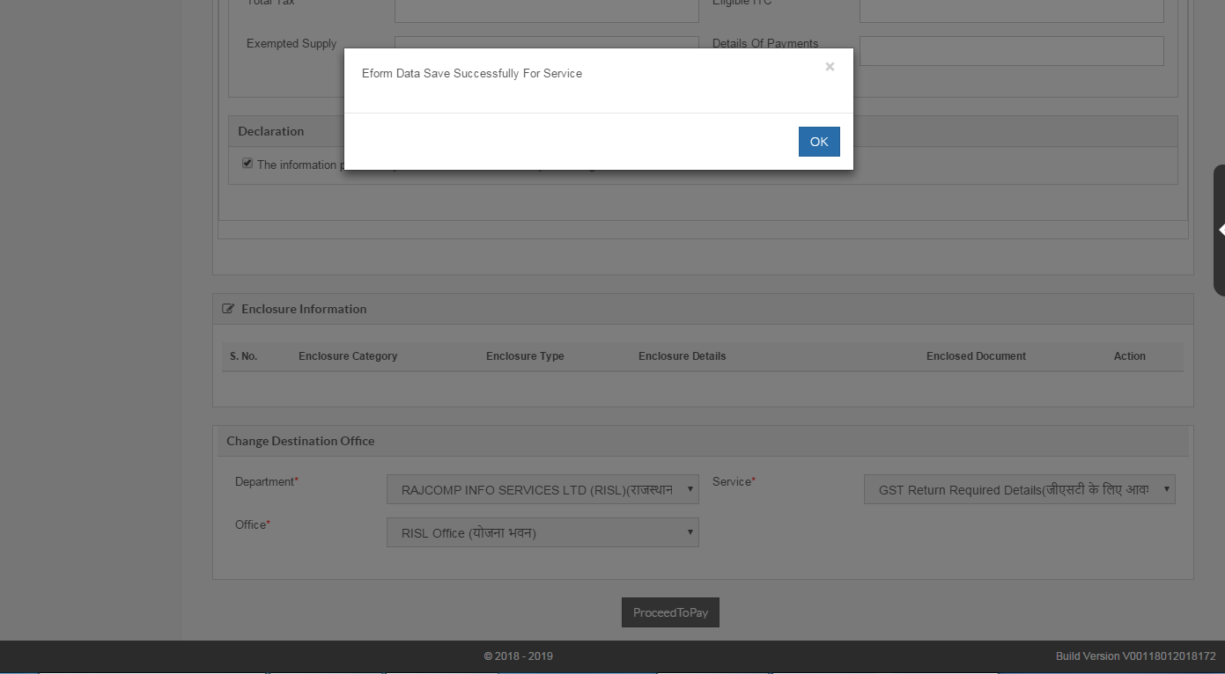
If you click OK option, again a Pop-up message “Eform Data Save Successfully For Service” will come, Now click OK button.

Slide 18
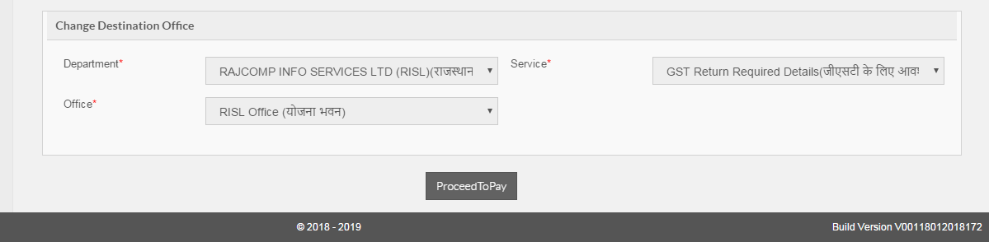
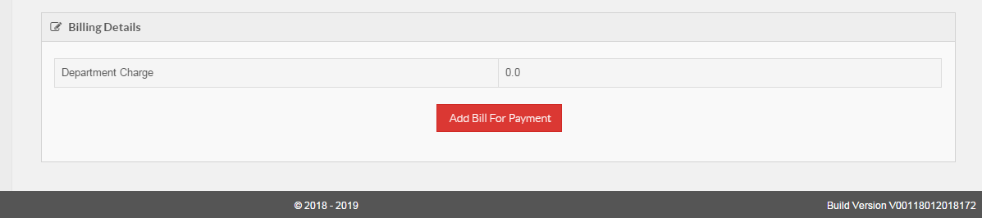
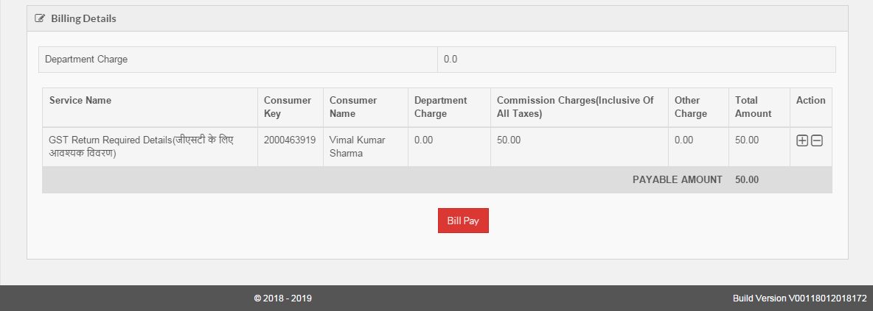
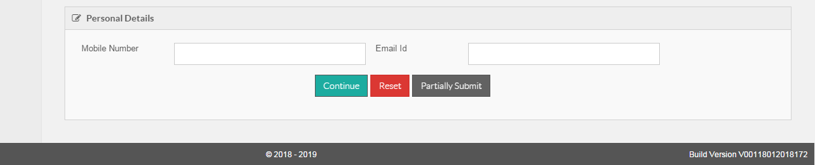
After click OK option, you need to click “ProcessToPay” option, Then click Add Bill for Payment Option & Bill Pay Option, Enter Mobile No. and Click Continue Button.

Slide 19
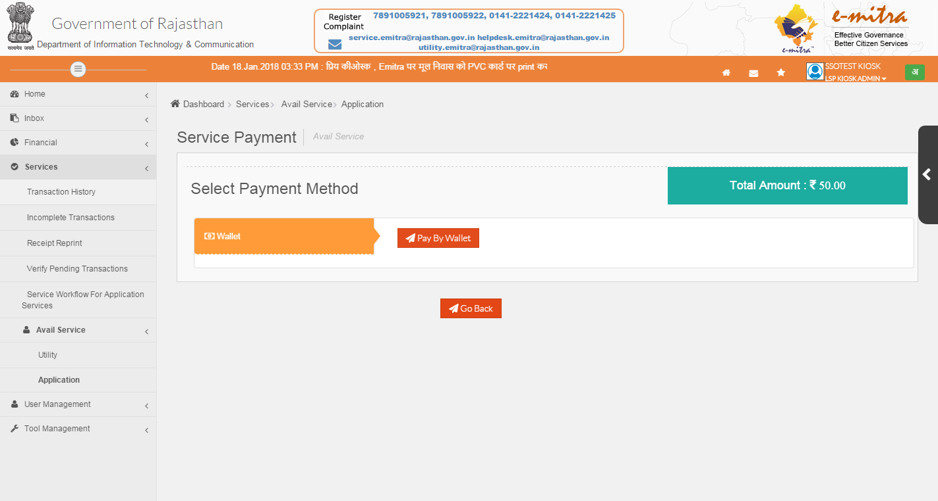
After Click Continue Option, New Page will come, here you can Choose payment modes & make payment.

